Slide 1
FIR Workbook (lab_3)
SOC Design

Slide 2
Function specification
Same as course-lab_2(FIRN11stream)
y[t] = Σ (h[i] * x[t - i])

Slide 3
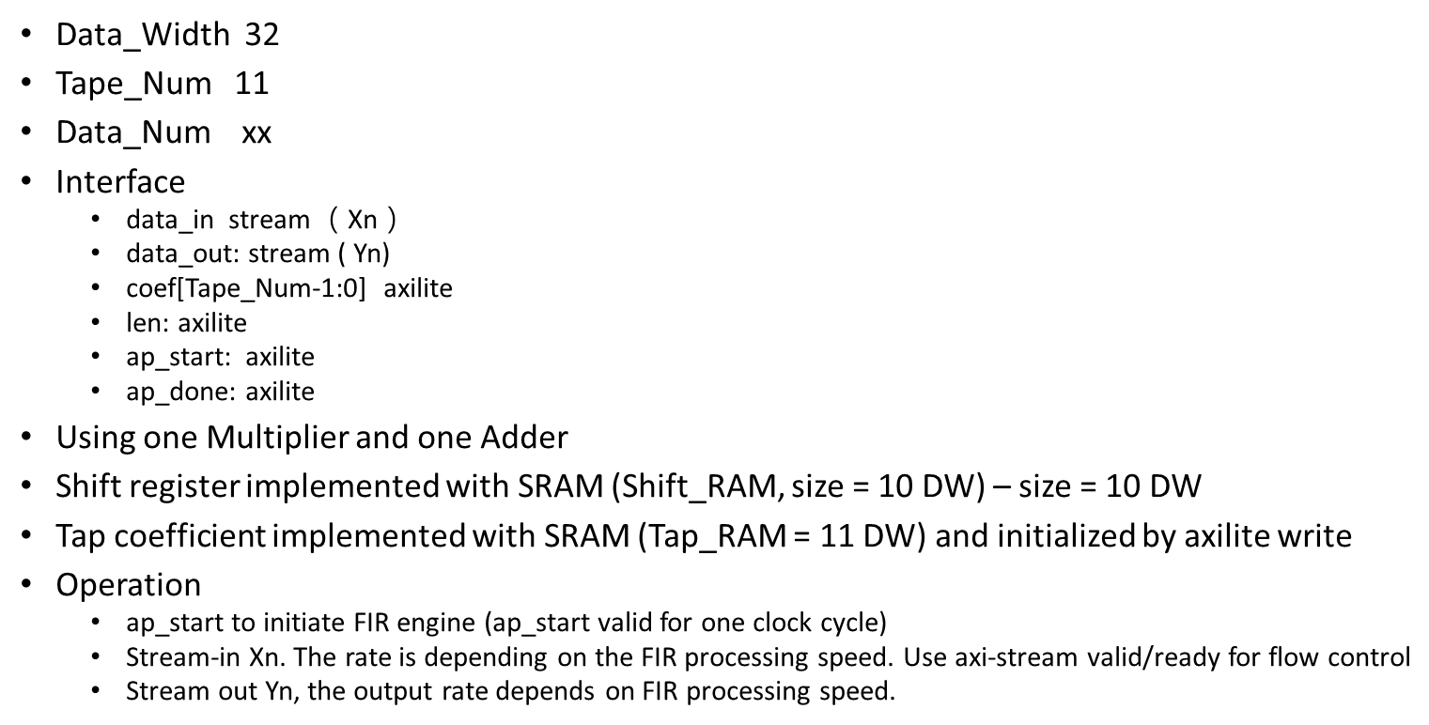
Design specification
600

Slide 4
Deliver module header
The I/O signals are listed in fir.v.
You are requested to use simplified AXI-lite and AXI-stream protocol.

Slide 5
FIR module interface
For your reference:
AXI-lite:
https://www.realdigital.org/doc/a9fee931f7a172423e1ba73f66ca4081
https://docs.xilinx.com/r/en-US/pg202-mipi-dphy/AXI4-Lite-Interface
AXI-stream:
https://developer.arm.com/documentation/ihi0051/latest/
https://docs.xilinx.com/r/en-US/pg256-sdfec-integrated-block/AXI4-Stream-Interface

Slide 6
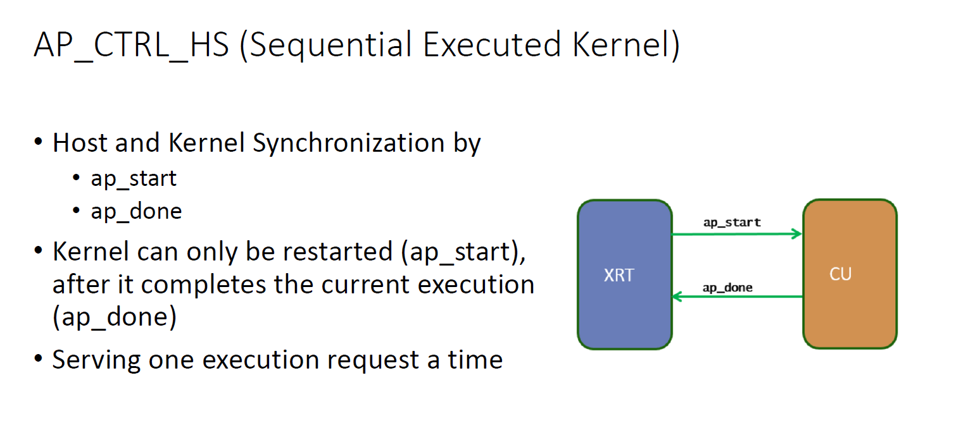
Testbench
fir_tb(Please name your top module same as fir.v for simulation)
The testbench should keep in the same directory with Makefile
Block-level Protocol (ap_start, ap_done):

Slide 7
Test dataset
Samples_triangular_wave.dat
out_gold.dat

Slide 8
Submission (1/2)
Hierarchy:
StudentID_lab3/
Waveform
Simulation.log
Report.pdf
Synthesis report
Github link
Your Github link should attach the file
Design, Synthesis report(Including FF, LUT, Bram ), Waveform, simulation.log, makefile,…etc.
Location of design (If use vivado to design)
hostproject/hostproject.srcs/sources_1/new/

Slide 9
Submission (2/2)
Compress all above files in a single zip file named
StudentID_lab3.zip (e.g., 111061545_lab3.zip)
Submit to NTHU eeclass
Deadline:
‐ 20% off for the late submission penalty within 3 days

